Slide 1
Analisa leksikal,kesalahan sintaks,dan semantik

Slide 2
Tekhnologi web
MongoDB(DBMS)
Express js(framework backend, web server)
Angular js(framework frontend)
Node js(web programing)
Socket io

Slide 3
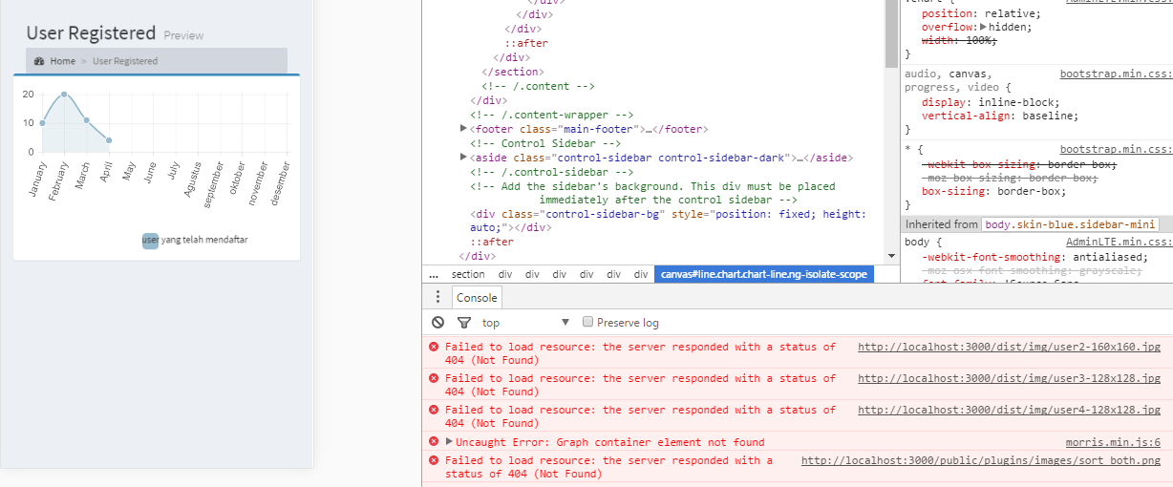
Kesalahan sintaks

Slide 4
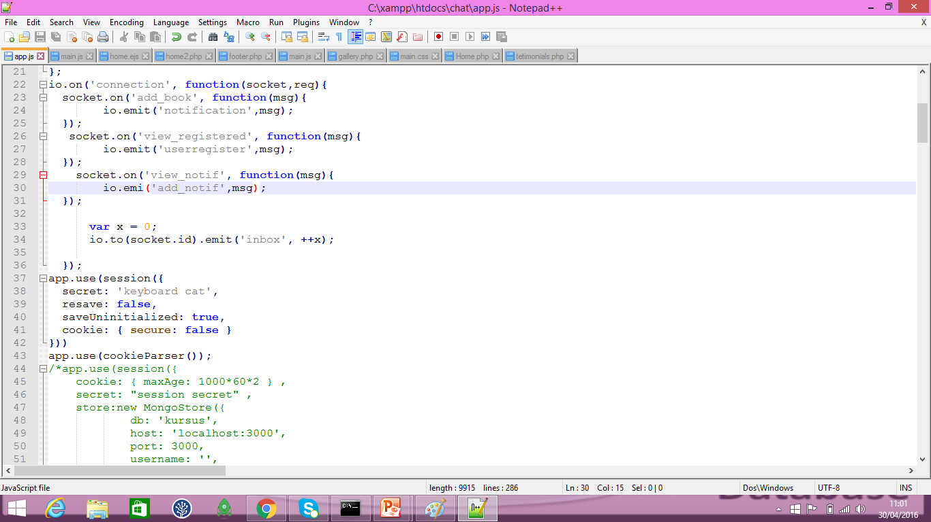
Analisa leksikal

Slide 5
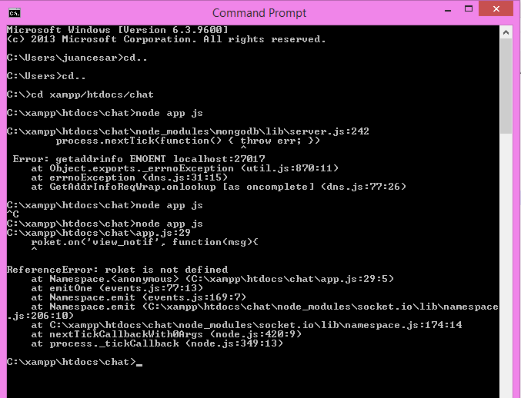
Kesalahan semantik

